Slide 1
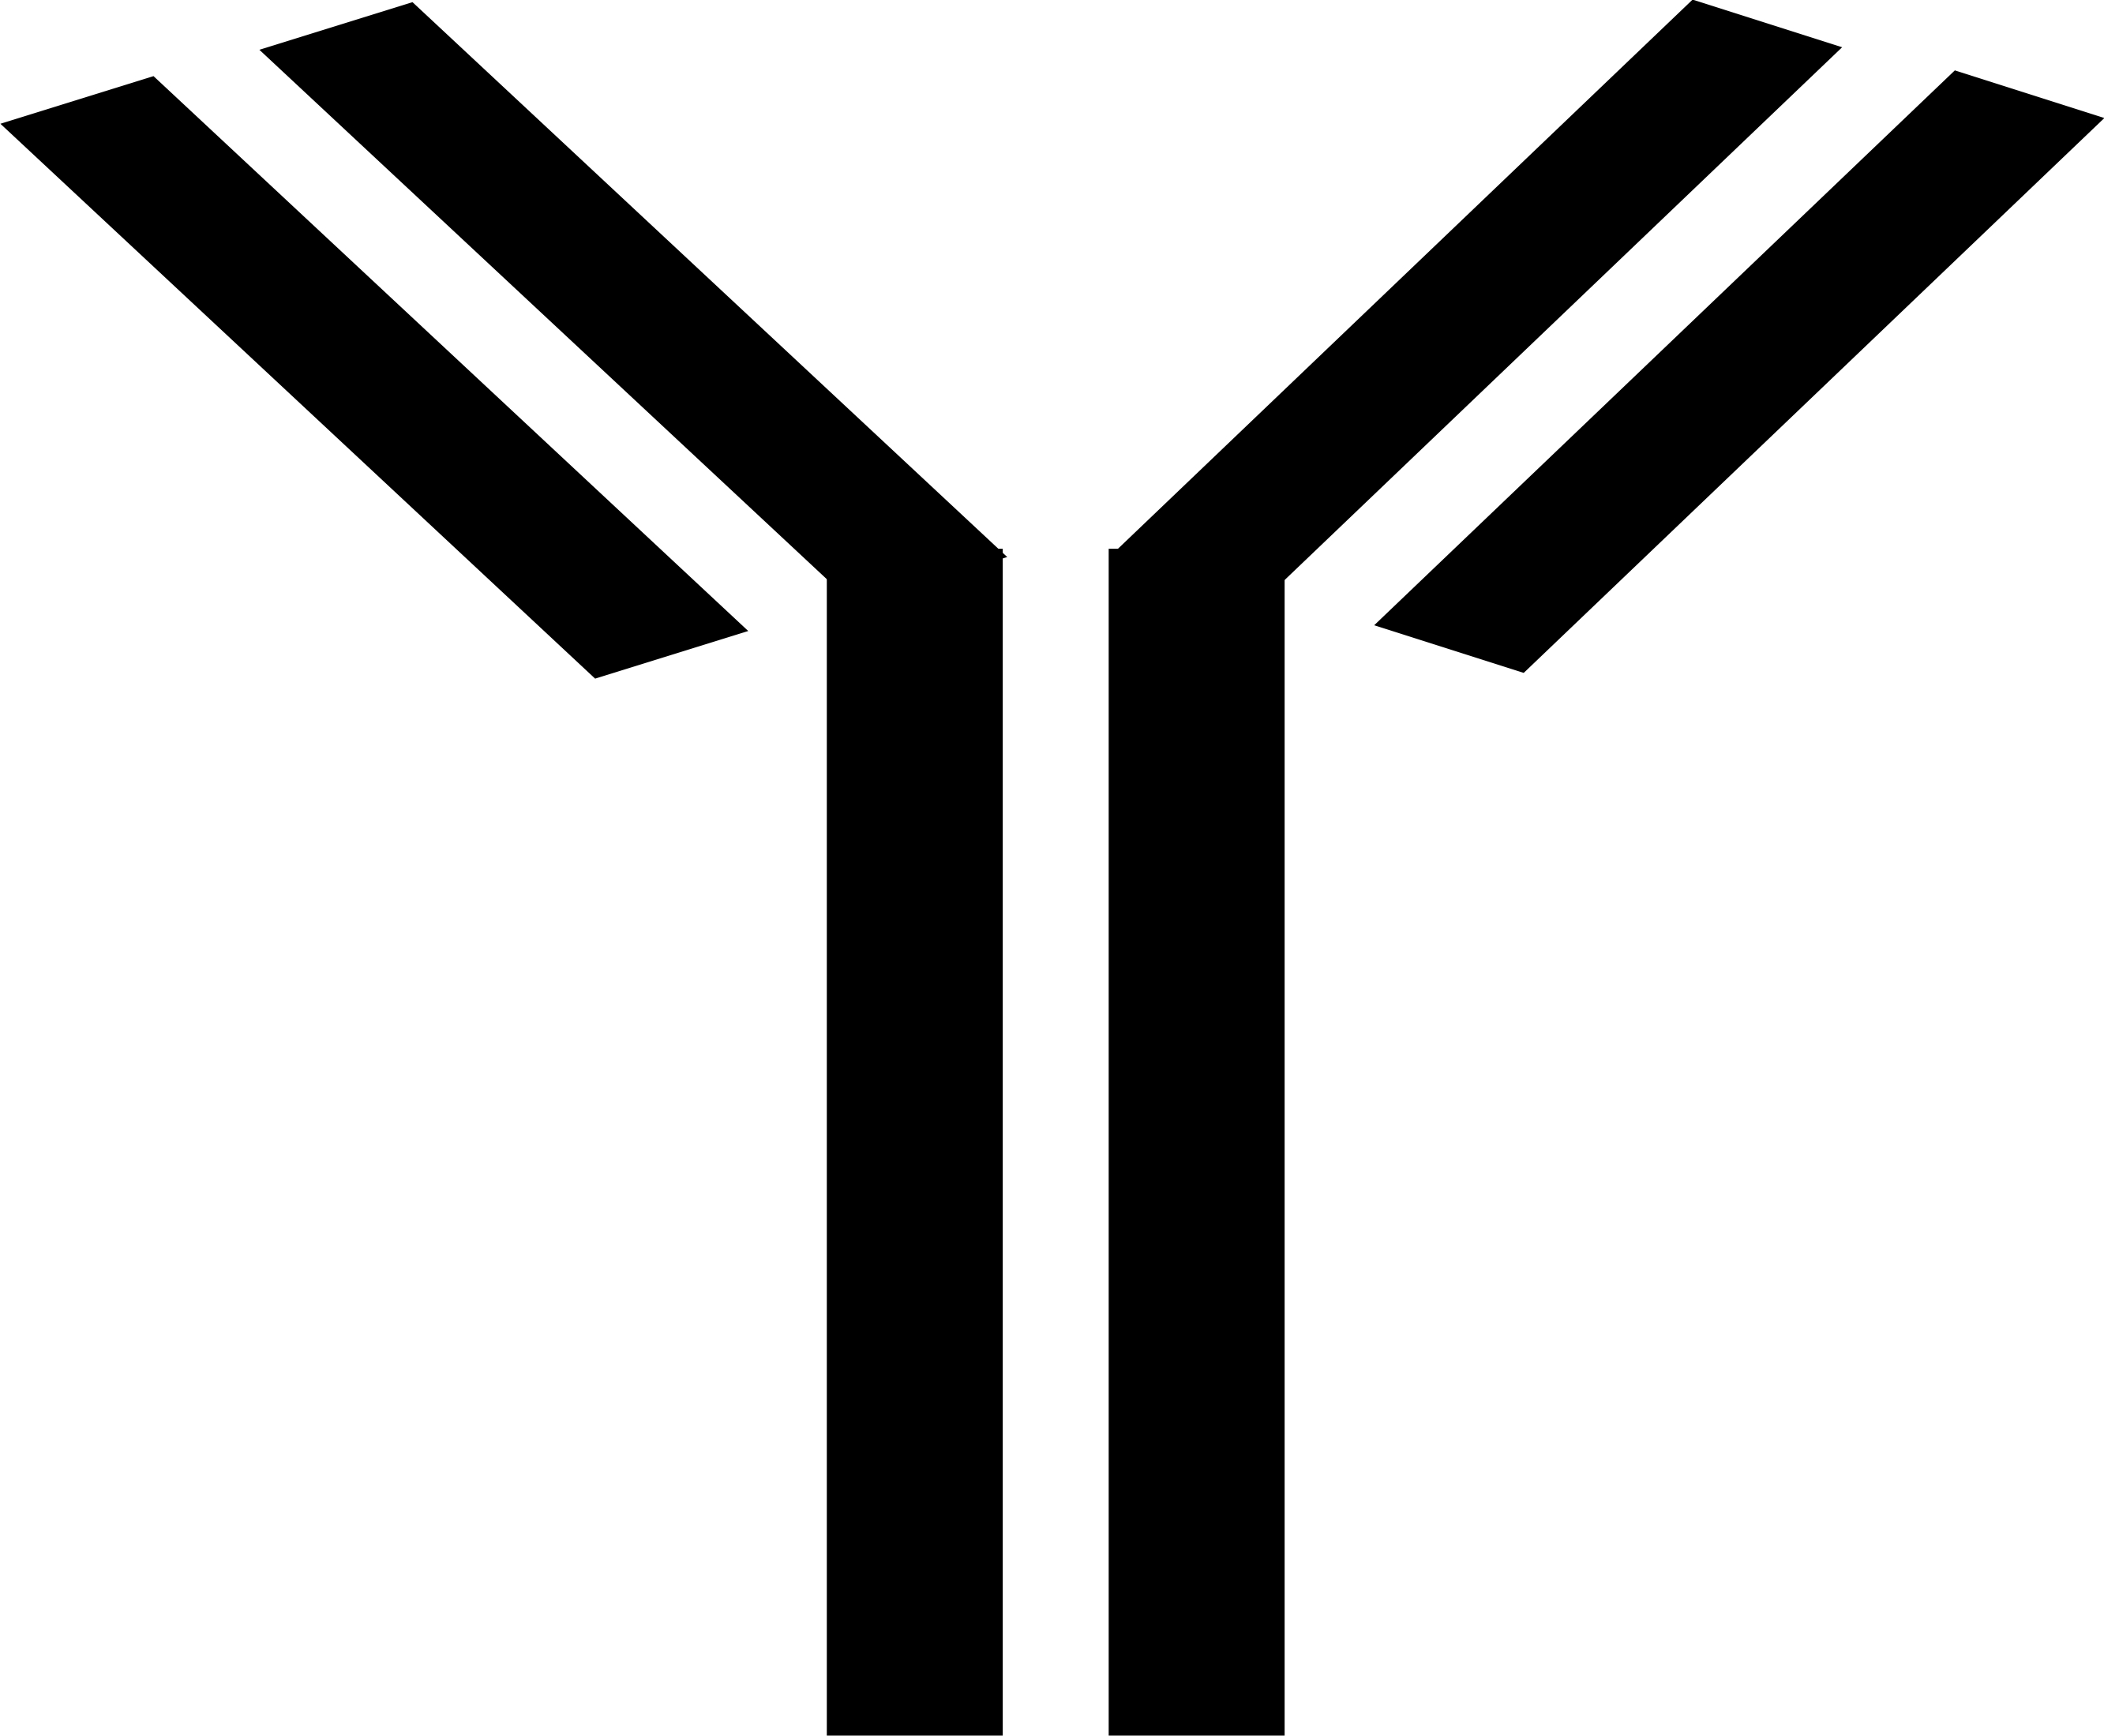
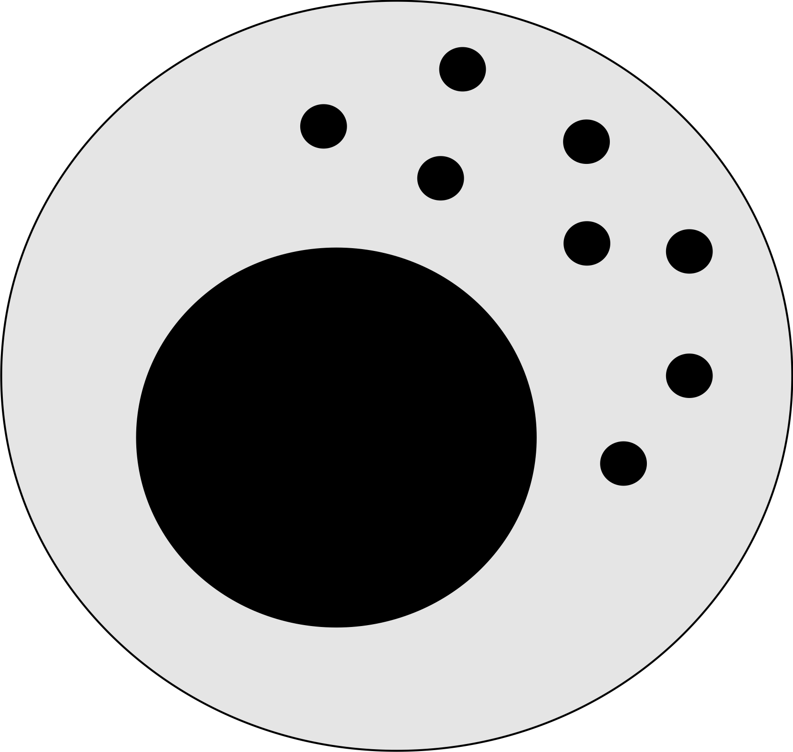
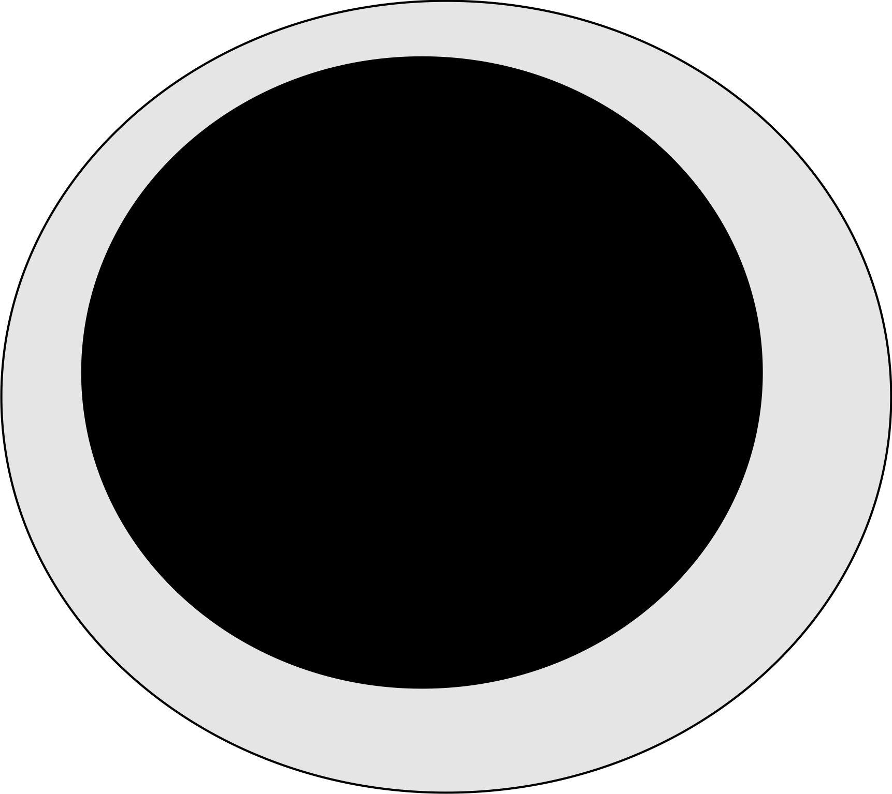
A
TNF-α dependent Apoptosis
TNF-α dependent Apoptosis
Natural death
Natural death
A₀
Ag
A_{a}
A_{s}
Natural death
Proliferation
A_{Ab}
A_{s_Ab}
TNF-α dependent Apoptosis
Natural death
Proliferation
Natural death
TNF-α dependent Apoptosis
B
Proliferation
Natural death
TNF-α dependent Apoptosis
Natural death
TNF-α dependent Apoptosis
N₀
Ag
N_{a}
N_{s}
Proliferation
N_{Ab}
N_{s_Ab}
Proliferation
Proliferation
Natural death
TNF-α dependent Apoptosis
Natural death
TNF-α dependent Apoptosis
C
Proliferation
TNF-α dependent Apoptosis
Natural death
Proliferation inhibition by CD137 blockade
TNF-α dependent Apoptosis
Enhanced Natural death by CD137 blockade

